Slide 1
NACo NATIONAL MEMBERSHIP CALL: PRELIMINARY REVIEW OF TREASURY’S FISCAL RECOVERY FUND GUIDANCE
MAY 11, 2021

Slide 2
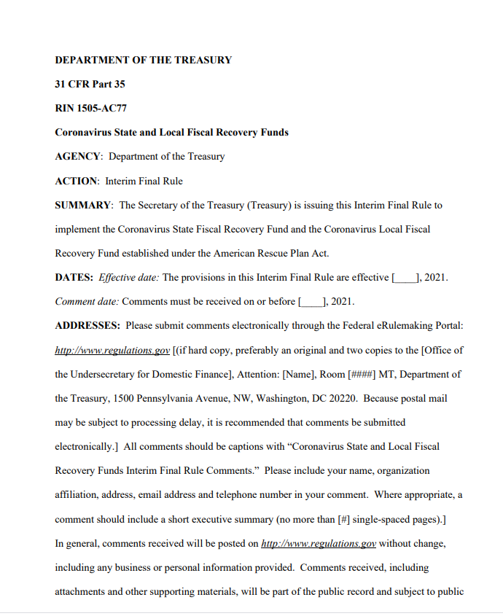
TABLE OF CONTENTS
How to register on U.S. Treasury’s portal and request Recovery Funds
New essential resources and guidance from U.S. Treasury
Interim final rule
Fact sheet
FAQs
Quick reference guide
County Recovery Fund allocations
Key Use of Funds and Reporting Dates
Key Terms of Art used in the Interim Rule
Defining eligible and ineligible uses
Support the public health response
Address negative economic impacts
Replace republic sector revenue loss
Broadband, water and sewer infrastructure
Reporting requirements
National Association of Counties | www.NACo.org | May 2021 | 2

Slide 3
QUICK TAKES ON RECOVERY FUNDS GUIDANCE
Historic investment in our nation’s counties
Opportunity to invest in local communities
Responded to NACo’s questions and recommendations
Broad flexibility in use of funds
Broadband
COVID-19 response
Payroll and benefits
Some unanswered questions
Opportunity to comment on the Interim Rule – July 9, 2021
National Association of Counties | www.NACo.org | May 2021 | 3
National Association of Counties | www.NACo.org | May 2021

Slide 4
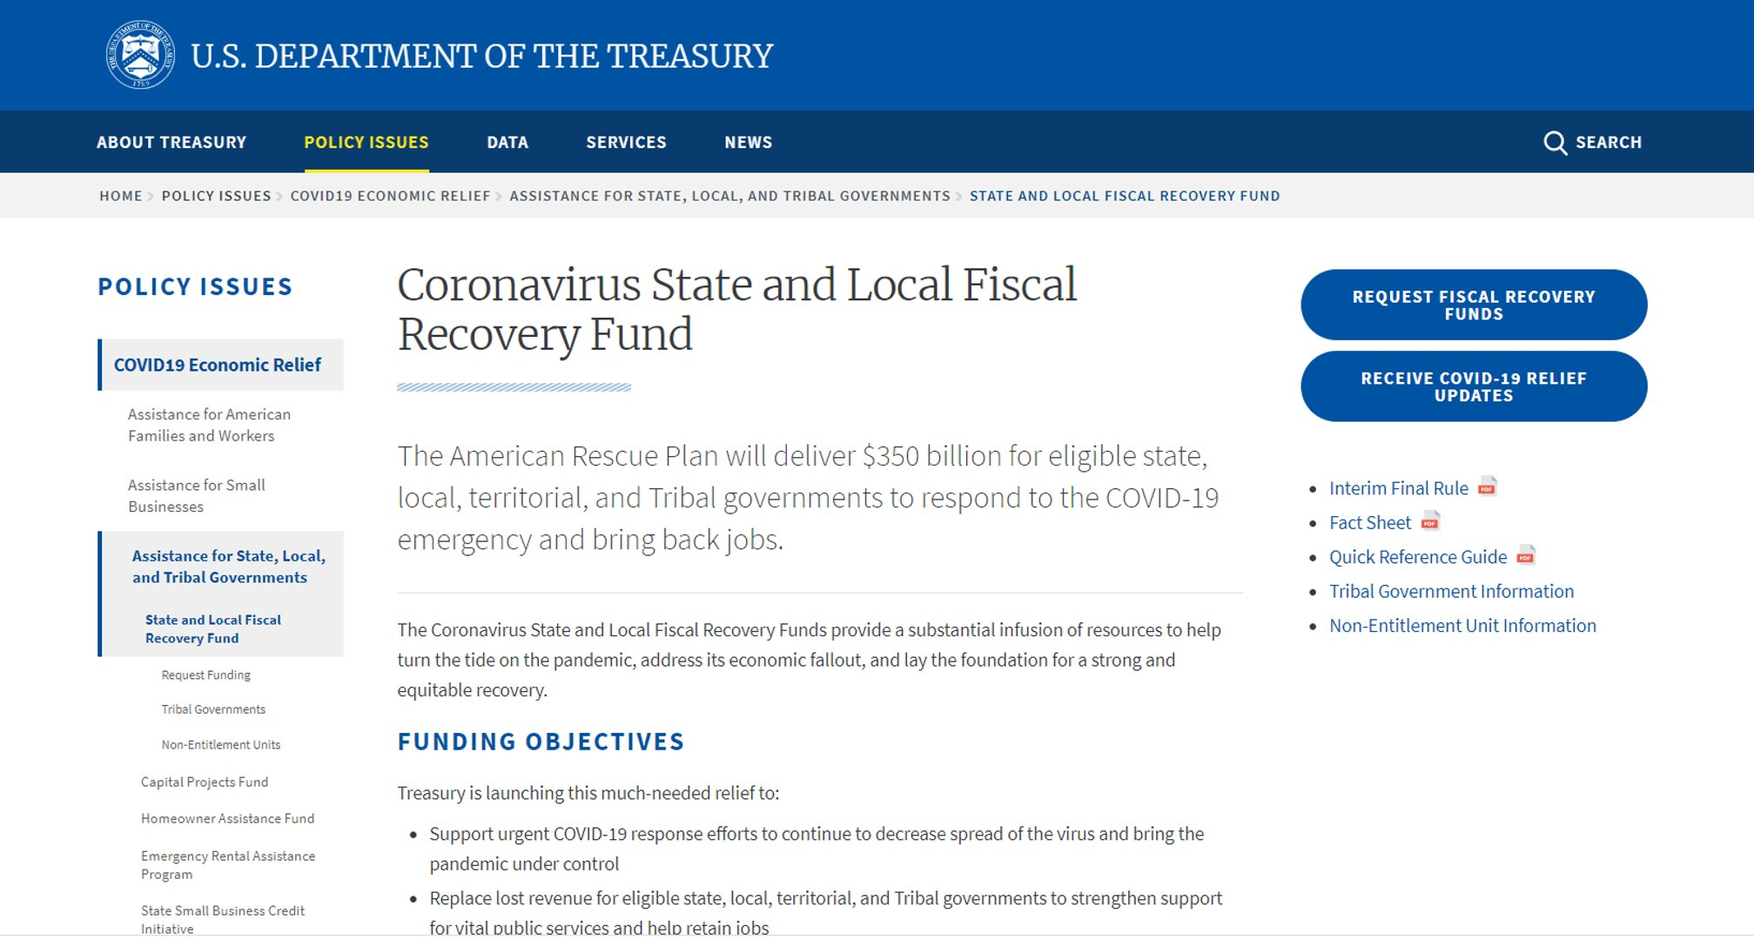
Interim final rule
Fact sheet
FAQs
Quick reference guide
County Recovery Fund allocations
U.S. TREASURY: “MUST READ” RESOURCES
National Association of Counties | www.NACo.org | May 2021 | 4
National Association of Counties | www.NACo.org | May 2021

Slide 5
DECODING THE LANGUAGE OF THE GUIDANCE
Throughout the Interim Final Rule, along with FAQs and fact sheets, U.S. Treasury uses various key words that are important to understand in determining the eligible use of funds. Please be sure to read pages 130-150 of the Interim Final Rule.
INTERIM FINAL RULE VS. FAQs
DEFINITIONS (PG. 130)
Shall = Mandatory reporting, use and compliance
May = Allows local/county discretion
Encourage / Should = Treasury preference only (NOT REQUIRED)
Proportional & Consistent
Covered benefits
Covered period
Eligible workers
General revenue
Pension fund
National Association of Counties | www.NACo.org | May 2021 | 5
National Association of Counties | www.NACo.org | May 2021

Slide 6
COMMON QUESTIONS ON RECOVERY FUNDS
HOW CAN COUNTIES USE RECOVERY FUNDS?
Capital improvements Public health Jail upgrades/replacement Stormwater improvements Roads and bridges Property tax relief Non-federal match Special purpose districts Compliance and audit costs | Interest bearing accounts (unclear) Pension funds Rainy day funds Revenue loss Entity-wide vs. per revenue stream Payroll support Debt service payments State Maintenance of Effort with County Funding
National Association of Counties | www.NACo.org | May 2021 | 6

Slide 7
KEY DATES RELATED TO THE RECOVERY FUND
January 27, 2020: Declaration of the public health crisis
March 3, 2021: Beginning of the Recovery Fund “covered period”
July 9, 2021: Deadline to comment on U.S. Treasury’s Interim Final Rule on Recovery Fund
August 31, 2021: Deadline to submit first Interim Report to U.S. Treasury
August 31, 2021: Deadline to submit first Recovery Plan Performance Report to U.S. Treasury - Applies to COUNTIES ABOVE 250,000 POPULATION ONLY
October 31, 2021: Deadline to submit first Quarterly Project and Expenditure Report
- Applies to ALL COUNTIES
December 31, 2024: Recovery Funds must be obligated (NOT incurred)
December 31, 2026: Recovery Funds must be spent & all work/performance must be completed
National Association of Counties | www.NACo.org | May 2021 | 7

Slide 8
HOW TO CERTIFY FOR RECOVERY FUNDS
U.S. Treasury released certification guidance and
opened the portal for counties to request Recovery Funds
Prior to requesting Recovery Funds, counties should complete the following steps immediately: ​
Ensure your county has a DUNS number​
Ensure your county has an active SAM registration​
Gather payment information:
Entity Identification Number (EIN), name and contact information​
Name and title of an authorized representative of the county (I.e. chief elected official)​
Financial institution information (e.g., routing and account number, financial institution name and contact information)​
National Association of Counties | www.NACo.org | May 2021 | 8

Slide 9
HOW TO CERTIFY FOR RECOVERY FUNDS
U.S. Treasury opened the portal for counties to request Recovery Funds.
To receive Recovery Funds, a county must request funds through this portal.
To access the portal and
request Recovery Funds
from the U.S. Treasury,
click here.
If you are having issues
with the new U.S. Treasury portal, email covidrelieffitsupport@treasury.gov.
National Association of Counties | www.NACo.org | May 2021 | 9
National Association of Counties | www.NACo.org | May 2021

Slide 10
HOW TO CERTIFY FOR RECOVERY FUNDS
U.S. Treasury is using the ID.me platform for counties to request Recovery Funds
​
ID.me is a trusted technology partner to multiple government agencies – your information is secure
Site provides secure digital identity verification to government agencies to ensure you are the correct individual requesting Recovery Funds
You are required to provide the following information to receive Recovery Funds:
Social Security Number
Driver's license/passport number
Facial recognition Your information will not be shared
National Association of Counties | www.NACo.org | May 2021 | 10

Slide 11
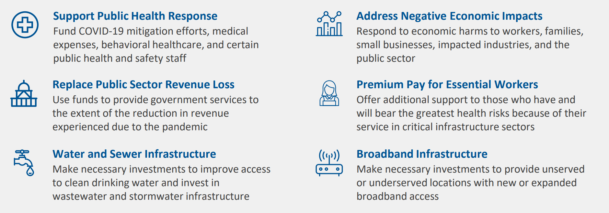
ILLUSTRATION ONLY OF SAMPLE ALLOWABLE USES OF RECOVERY FUNDS,
PER NEW U.S. TREASURY GUIDANCE
National Association of Counties | www.NACo.org | May 2021 | 11

Slide 12
SUPPORT PUBLIC HEALTH RESPONSE
1
COVID-19 MITIGATION
& CONTAINMENT
A broad range of services and programming that are needed to contain COVID-19
Provide care and services to address COVID-19 public health needs, risks presented by new variants and long-term effects of the virus
New or enhanced state and local government services that may be needed to meet mental health, substance use and other behavioral health needs
Responding to the public health and negative economic impacts COVID-19 and requires additional human resources
2
MEDICAL EXPENSES
3
BEHAVIORAL HEALTHCARE
4
PUBLIC HEALTH
& SAFETY STAFF
National Association of Counties | www.NACo.org | May 2021 | 12

Slide 13
ADDRESS NEGATIVE ECONOMIC IMPACTS
1
Assistance to unemployed workers and job training
Food, housing, cash and other assistance to households (proportionate)
Survivor’s benefits for family members of COVID-19 victims
WORKERS & FAMILIES
2
Loans and grants to mitigate financial hardship
Loans, grants and in-kind assistance to implement COVID-19 prevention or mitigation tactics
Technical assistance
SMALL BUSINESS
3
Rehire staff
Replenish state unemployment insurance funds
Administer economic relief programs
PUBLIC SECTOR
4
IMPACTED
INDUSTRIES
Tourism, travel and hospitality
Other similarly affected sectors
National Association of Counties | www.NACo.org | May 2021 | 13

Slide 14
PROVIDE EQUITY-FOCUSED SERVICES
1
ADDRESSING HEALTH
DISPARITIES
Community health workers and public benefits navigators
Remediation of lead paint and other lead hazards
Community violence intervention programs
2
Services to support individuals experiencing homelessness
Affordable housing development
Housing vouchers, residential counseling, navigation assistance
HOUSING &
NEIGHBORHOODS
3
EDUCATIONAL
DISPARITIES
New or expanded early learning services
Expanded resources for high-poverty school districts
Educational services like tutoring and afterschool programs
4
PROMOTING
HEALTHY CHILDHOOD
ENVIRONMENTS
New and expanded high quality childcare
Home visiting programs for families with young children
Services for child welfare-involved families and foster youth
National Association of Counties | www.NACo.org | May 2021 | 14

Slide 15
REPLACE LOST REVENUE
Recovery Funds may be used to provide government services to the extend of reduction in revenue experienced due to COVID-19:
Definition of general revenue: Based on Census Bureau’s definition and includes revenue from taxes, current charges, miscellaneous general revenue, intergovernmental transfers between state and local governments
Excludes refunds and other correction transactions proceeds from issuance of debt or the sale of investments, agency or private trust transactions and revenue generated by utilities, intergovernmental transfers from the federal government (federal transfers made to a state/locality)
Recipients should calculate revenue on an entity-wide basis
Recipients cannot use pre-pandemic projections as a basis to estimate the reduction in revenue
Recipients can use funds to support governments services, which include, but are not limited to:
Maintenance of infrastructure or pay-go spending for building new infrastructure, including roads
Modernization of cybersecurity, including hardware, software and protection of critical infrastructure
Health services
Environment remediation
School or educational services
Police, first responders and other public safety services
National Association of Counties | www.NACo.org | May 2021 | 15

Slide 16
REPLACE LOST REVENUE
U.S. Treasury’s guidance establishes new methodology to calculate lost revenue.
Recipients have two options to calculate lost revenue:
Recipients will compute the extent of reduction in revenue by comparing actual revenue to a counterfactual trend representing what could have plausibly been expected to occur in the absence of the pandemic
Analysis of this expected trend begins with the last full fiscal year prior to the public health emergency (I.e. prior to January 27, 2020) and projects forward at either:
Recipient’s average annual revenue growth over the three full fiscal years prior to the public health emergency, or
4.1%, the national average state and local revenue growth rate from 2015-18 (the latest available data).
National Association of Counties | www.NACo.org | May 2021 | 16

Slide 17
REPLACE LOST REVENUE
Additional guidance related to calculating “lost revenue”:
Recipients should calculate the extent of the reduction in revenue as of four points in time: December 31, 2020; December 31, 2021; December 31, 2022; and December 31, 2023.
To calculate the extent of the reduction in revenue at each of these dates, recipients should follow a four-step process:
Identify revenues collected in the most recent full fiscal year prior to the public health emergency (i.e., last full fiscal year before January 27, 2020), called the base year revenue
Estimate counterfactual revenue
Identify actual revenue, which equals revenues collected over the past
The extent of the reduction in revenue is equal to counterfactual revenue less actual revenue. If actual revenue exceeds counterfactual revenue, the extent of the reduction in revenue is set to zero for that calculation date
National Association of Counties | www.NACo.org | May 2021 | 17

Slide 18
PREMIUM PAY FOR ESSENTIAL EMPLOYEES
Fiscal Recovery Funds payments may be used by recipients to provide premium pay ($13/per hour) to eligible workers performing essential work during the COVID-19 public health emergency or to provide grants to third-party employers with eligible workers performing essential work.
Essential employees are defined as:
Any work performed by an employee of the state, local or tribal government
Staff at nursing homes, hospitals, and home care settings
Workers at farms, food production facilities, grocery stores, and restaurants
Janitors and sanitation workers
Truck drivers, transit staff, and warehouse workers
Public health and safety staff
Childcare workers, educators, and other school staff
Social service and human services staff
Essential work is defined as:
Work involving regular in-person interactions or regular physical handling of items that were also handled by others
A worker would NOT be engaged in essential work and, accordingly may not receive premium pay, for telework performed from a residence
Other provisions related to premium pay:
Premium pay can be retroactive
Recipients have discretion to designate additional sectors
Additional reporting requirements in certain cases (grants to third-party employers)
National Association of Counties | www.NACo.org | May 2021 | 18

Slide 19
WATER, SEWER & BROADBAND INFRASTRUCTURE
To assist in meeting the critical need for investments and improvements to existing infrastructure in water, sewer and broadband, counties can invest Fiscal Recovery Funds into these sectors:
WATER & SEWER INFRASTRUCTURE
BROADBAND INFRASTRUCTURE
Improvements to infrastructure, such as building or upgrading facilities and transmission, distribution and storage systems (additional guidance to be released at later date)
Eligible uses aligned to Environmental Protection Agency (EPA) project categories in the:
Clean Water State Revolving Fund (CWSRF)
Drinking Water State Revolving Fund (DWSRF)
Targets to support households and businesses that do not deliver 25 Mbps download/3 Mbps upload
Fund projects that deliver reliable services – minimum 100 Mbps download/100 Mbps upload speed unless impracticable due to geography, topography, or excessive costs
Complement broadband investments made through the Capital Projects Funds authorized under ARPA
National Association of Counties | www.NACo.org | May 2021 | 19

Slide 20
DEFINING INELIGIBLE EXPENSES
1
PENSION FUNDS
Funding cannot be used for deposits into defined benefit pension funds…However, Treasury defines a “deposit” as an extraordinary contribution to a pension fund for the purpose of reducing an accrued, unfunded liability
Recipients may use funds for routine payroll contributions to pensions of employees whose wages and salaries are an eligible use
2
OTHER RESTRICTIONS
Funding debt service, legal settlements or judgements
Deposits to rainy day funds or financial reserves
Non-federal match requirement (I.e. EDA & Medicaid) & be sure to reach the latest FEMA guidance
The President’s directive allows FEMA to pay 100% federal funding for the costs of activities that have previously been determined eligible, from the beginning of the pandemic in January 2020 to Sept. 30, 2021.
NET REDUCTION IN TAX REVENUE
(LIMITED TO TATE & TERRITORIES)
3
If a state or territory has a reduction in net tax revenue, they must demonstrate how they paid for the tax cuts from source other than the Recovery Fund
National Association of Counties | www.NACo.org | May 2021 | 20

Slide 21
REPORTING REQUIREMENTS
Recovery Fund recipients will be required to submit an interim report, quarterly report, quarterly project and expenditure reports and annual recovery plan:
Interim reports: Counties will be required to submit one interim report, which will include the county’s expenditures by category at the summary level. The interim report will cover spending from the date the county receives Recovery Funds to July 31, 2021. Interim reports are due by August 31, 2021.
Quarterly project and expenditure reports: Counties will be required to submit quarterly project and expenditure reports, which will include financial data, information on contracts and subawards over $50,000 and other information regarding utilization of funds. These reports will be similar to CARES Act Coronavirus Relief Fund. The first report will cover spending from the date the county receives Recovery Funds to September 30, 2021. First report is due by October 31, 2021.
Recovery plan performance reports: Counties will be required to submit an annual recovery plan performance report, which will include descriptions of projects funded and information on performance indicators and objectives of each award. Initial recovery plan will cover activity from the date the county receives Recovery Funds to July 31, 2021. Local governments with less than 250,000 residents are not required to develop Recovery Plan Performance Report. Recovery plan is due by August 31, 2021.
Local governments with less than 250,000 residents are not required to develop Recovery Plan Performance Report.
National Association of Counties | www.NACo.org | May 2021 | 21

Slide 22
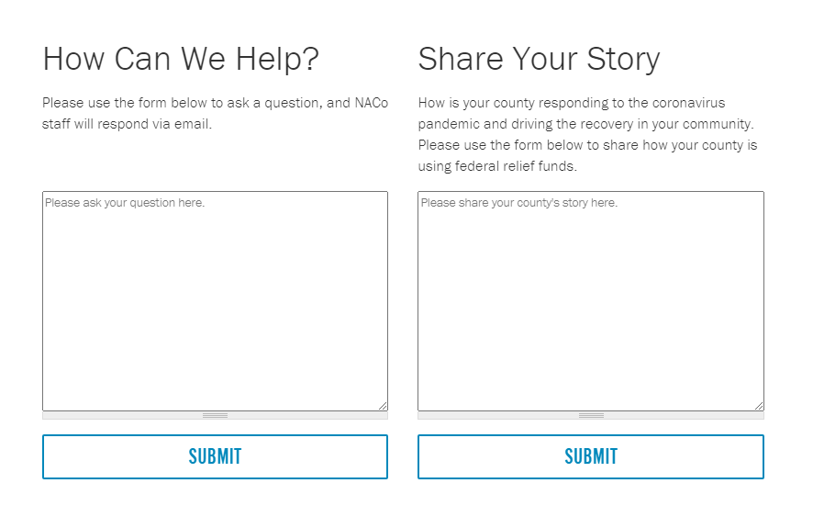
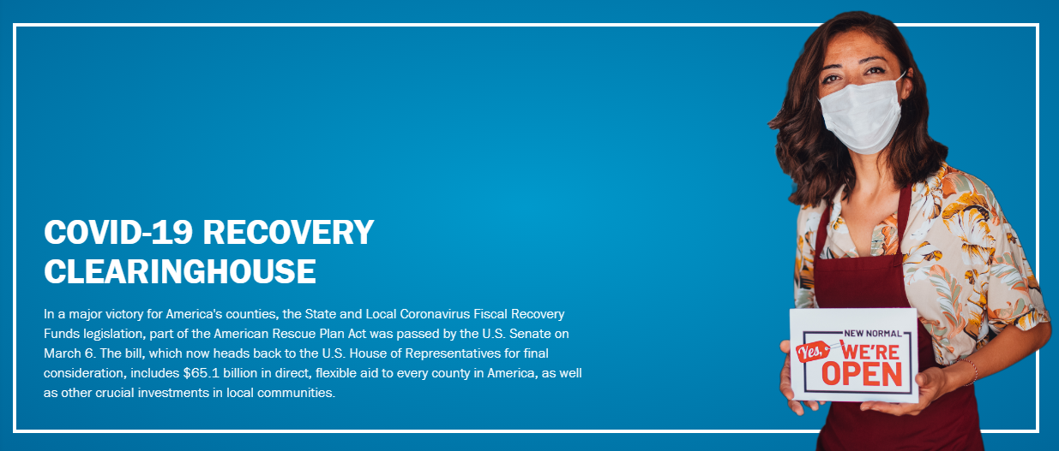
COVID-19 Recovery Clearinghouse (naco.org)
NACo
22

Slide 23
2021 NACo ANNUAL HYBRID CONFERENCE
GAYLORD NATIONAL RESORT & CONVENTION CENTER, PRINCE GEORGE’S COUNTY, MD | JULY 9-12

Slide 24
National Association of Counties
660 North Capitol Street, N.W. | Suite 400
Washington, D.C. 20001
202.393.6226 • www.NACo.org
fb.com/NACoDC
@NACoTweets
youtube.com/NACoVideo
linkedin.com/company/NACoDC
STRONGER COUNTIES. STRONGER AMERICA.

